Slide 1

Introducing {workboots}
Generate prediction intervals from tidymodel workflows
Mark Rieke
@markjrieke
2022-07-27
<link to slides>
Notes:
Hi everyone! Thank you for coming to my talk. My name is Mark Rieke and today I’ll be introducing workboots, which is a package for generating prediction intervals from a tidymodel workflow.
Before we get into that, I want to talk about tools!
I do a lot of home improvement projects, so I’ve seen a wide variety of *interesting* tools

Slide 2
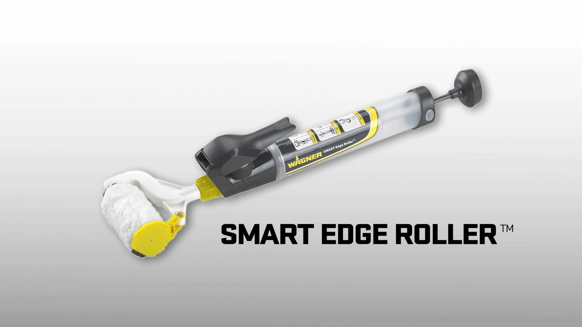

Slide 3
paint brush with bluetooth

Slide 4
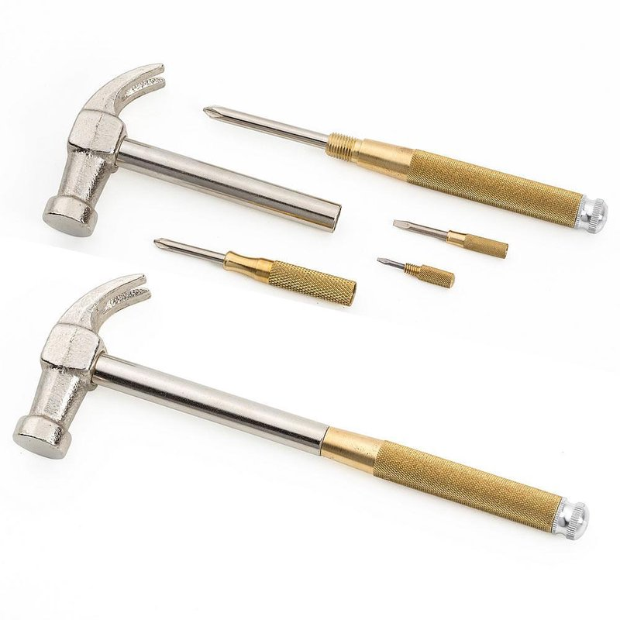

Slide 5
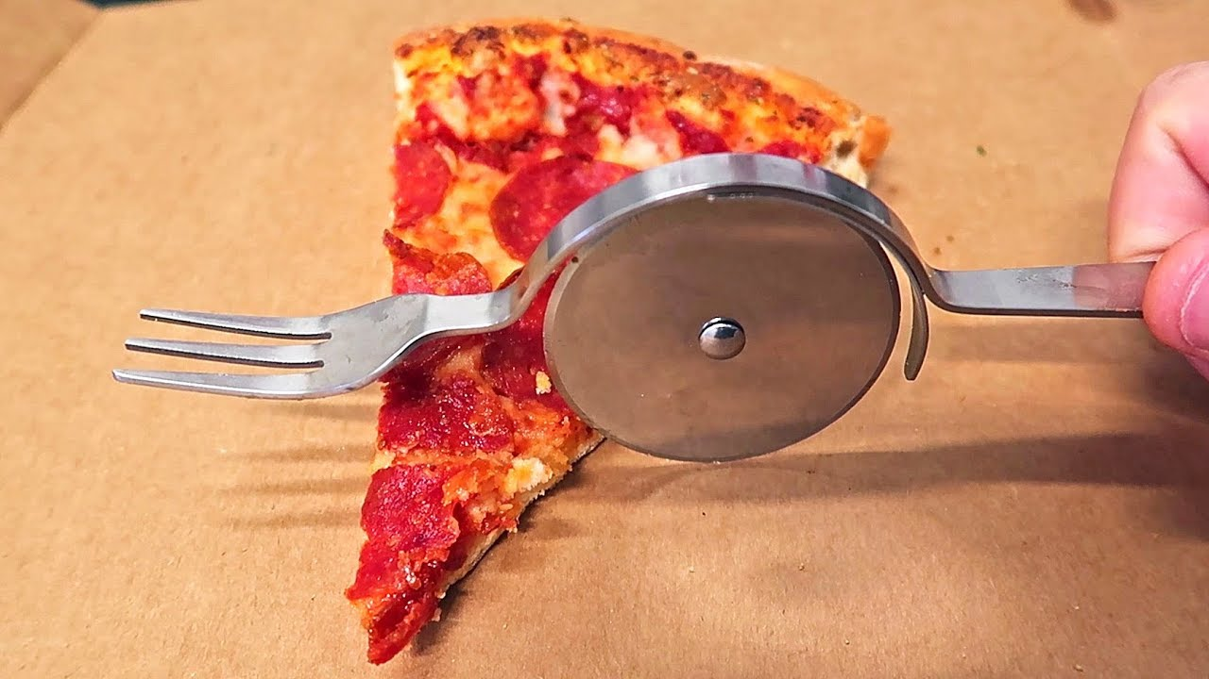

Slide 6
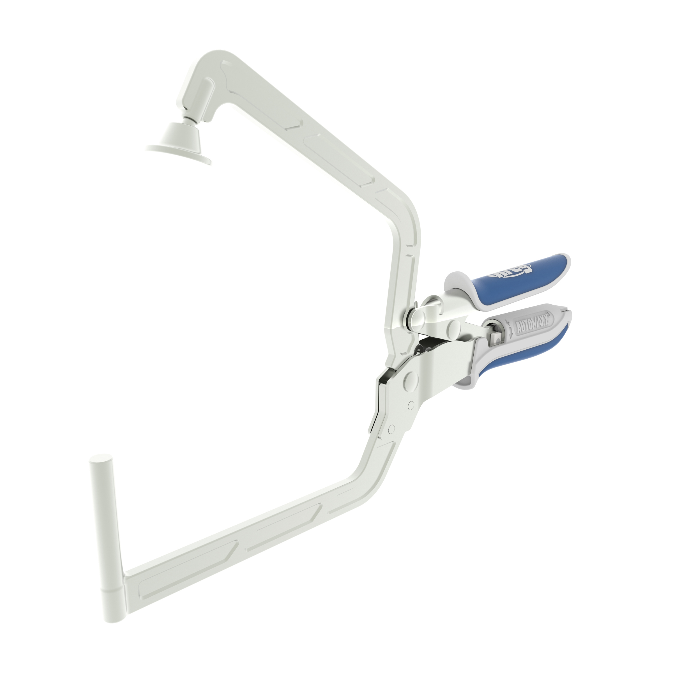
Update with mine later

Slide 7
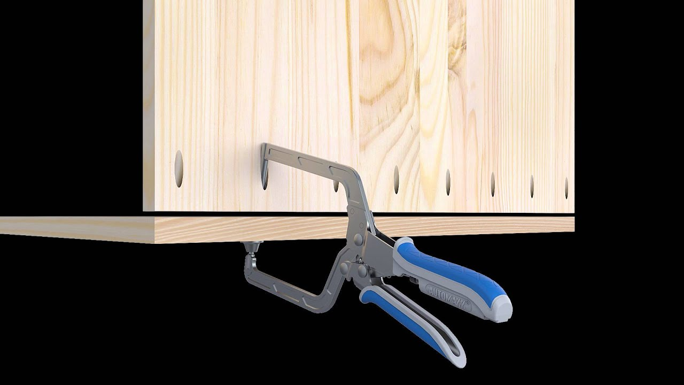
Update with mine later
Notes:
“Right tool for the right job”

Slide 8
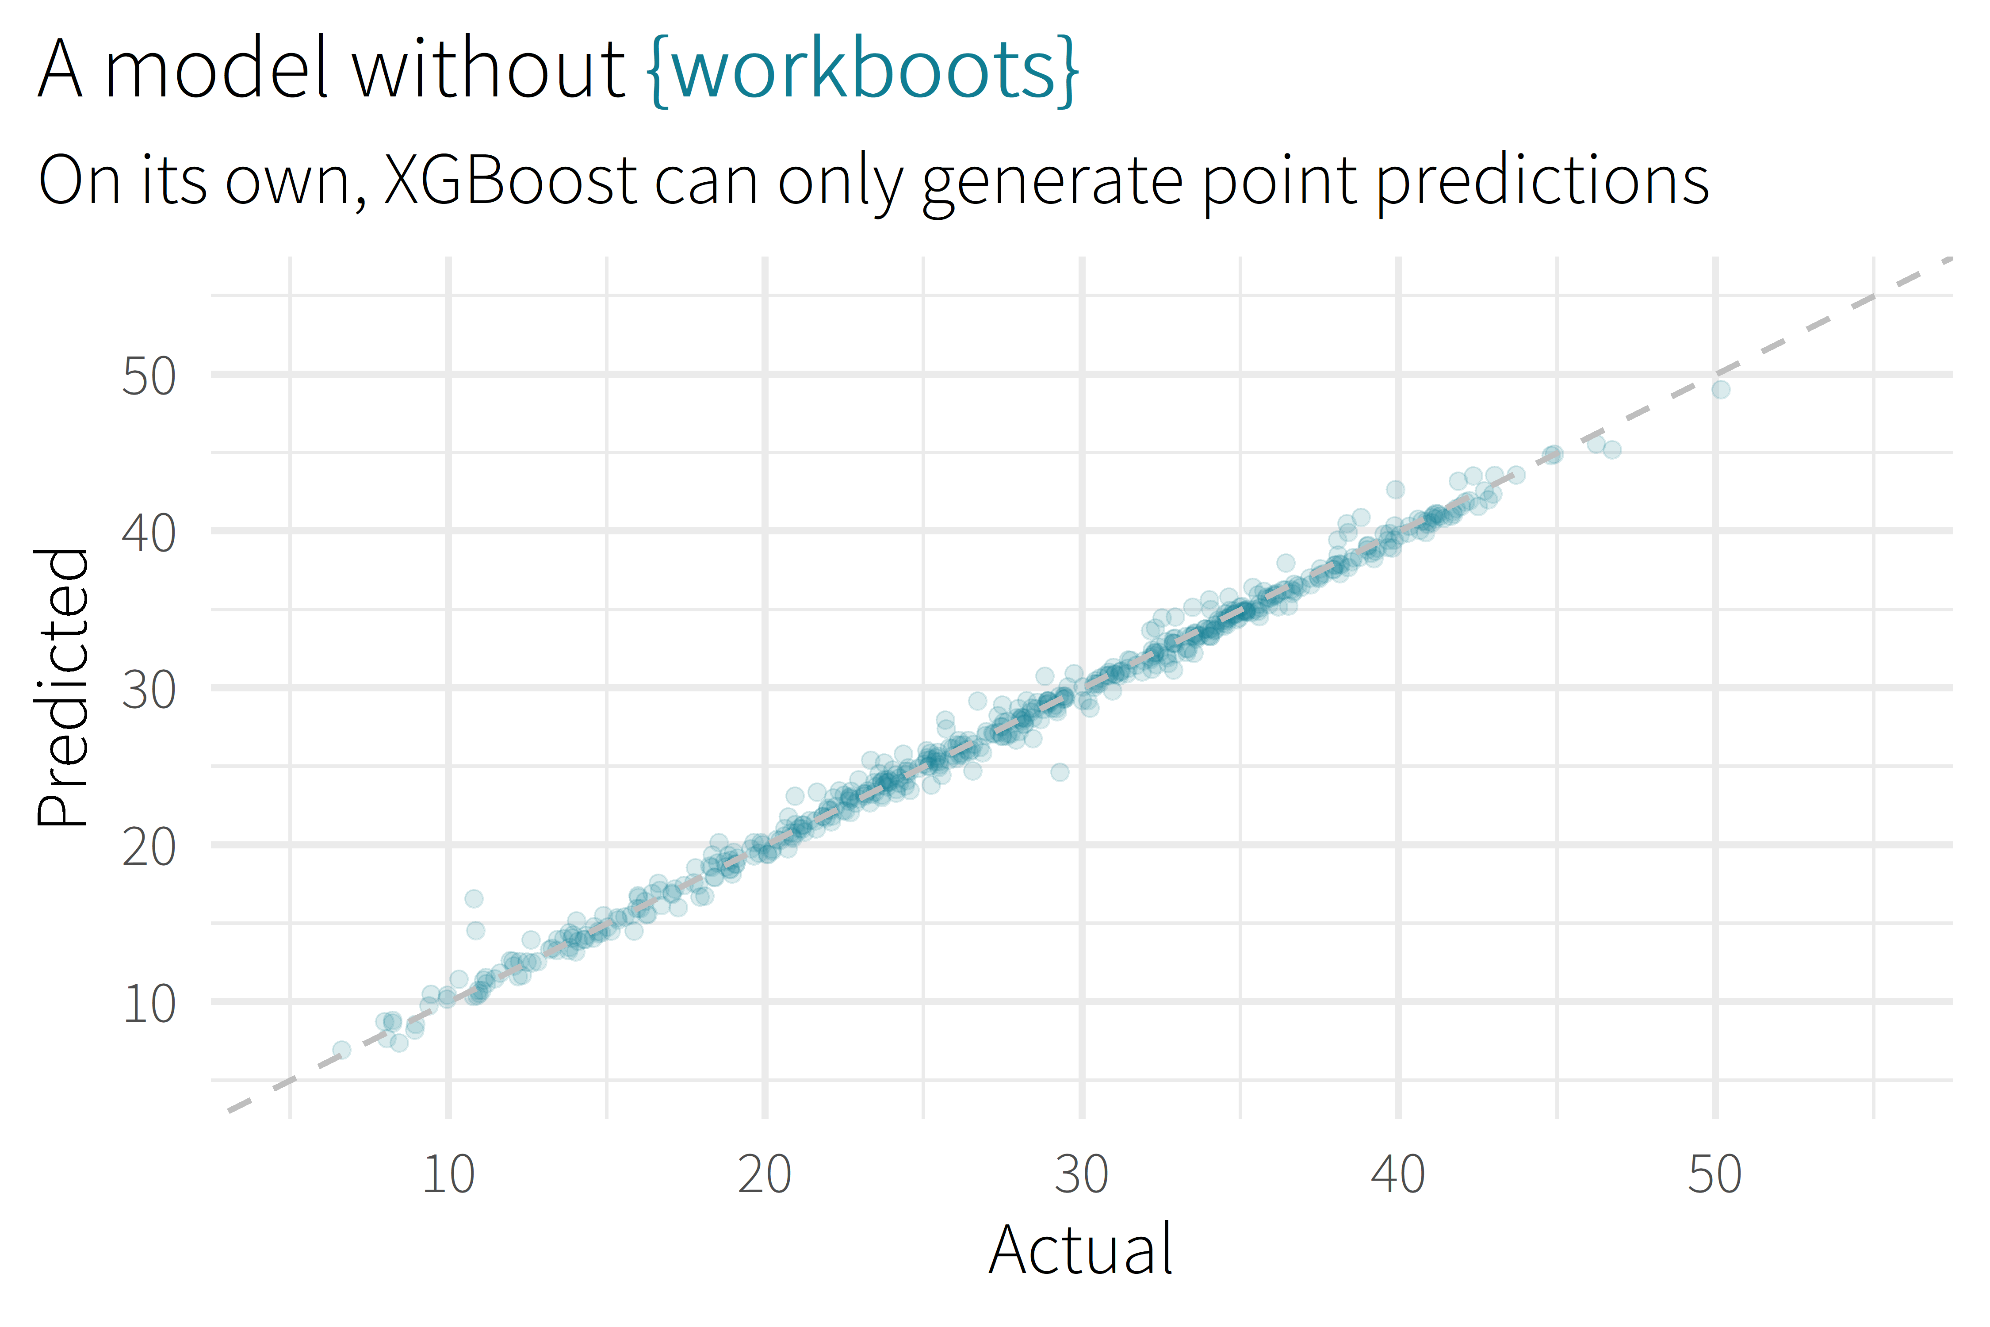

Slide 9
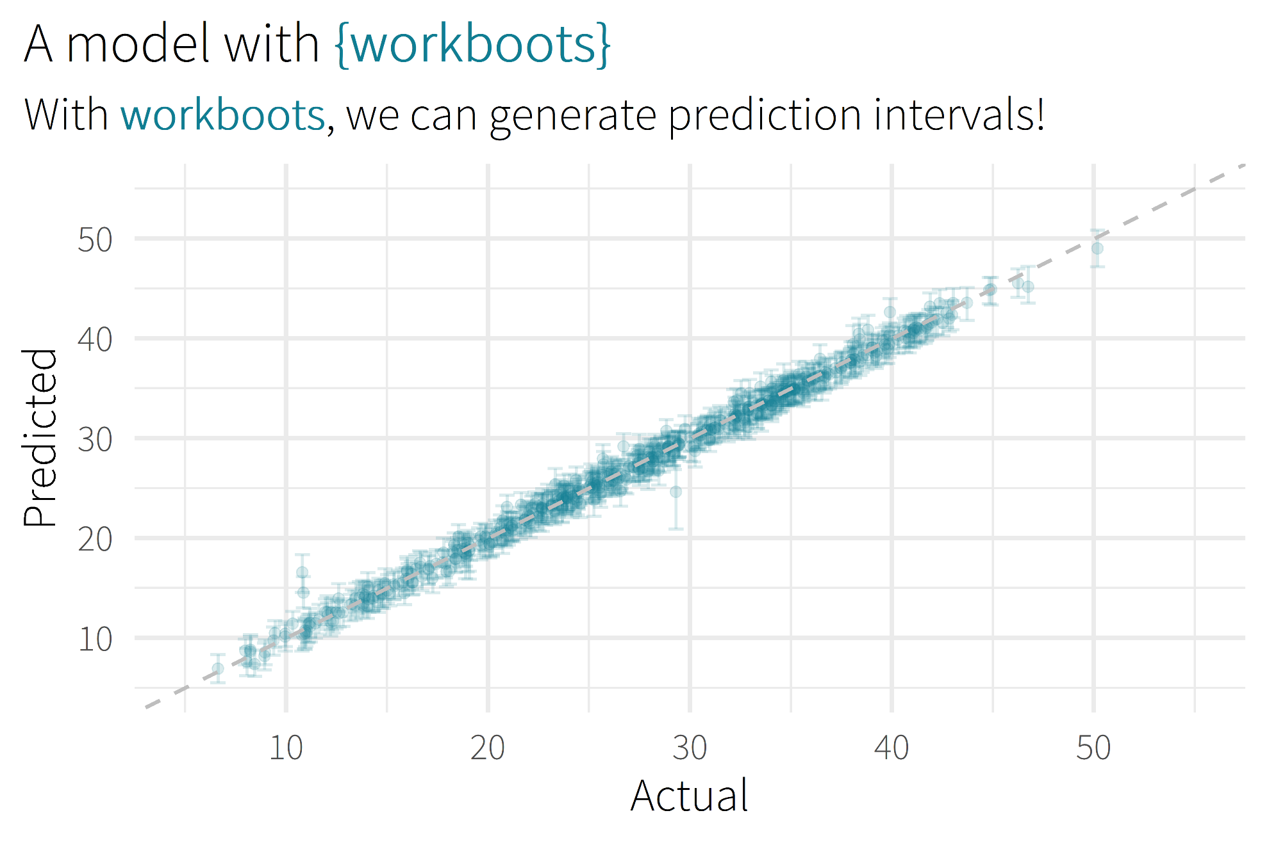

Slide 10

Motivation/Background

Slide 11
background
Why you might want to use? (role as analyst)
Checks to hit before use

Slide 12

about me
Sr. CX Analyst, MHHS
Patient satisfaction survey data
Administer, understand, improve
Answering questions
Notes:
Senior consumer experience analyst for Memorial Hermann Health System
Large hospital system in Houston
17 hospitals (11 acute-care)
Hundreds of clinics
Around 30,000 employees
Small but mighty team of 4 – thankful that they’re holding down the fort
Work with patient satisfaction surveys

Slide 13
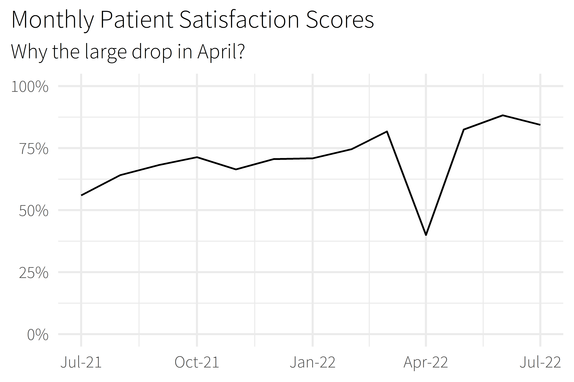
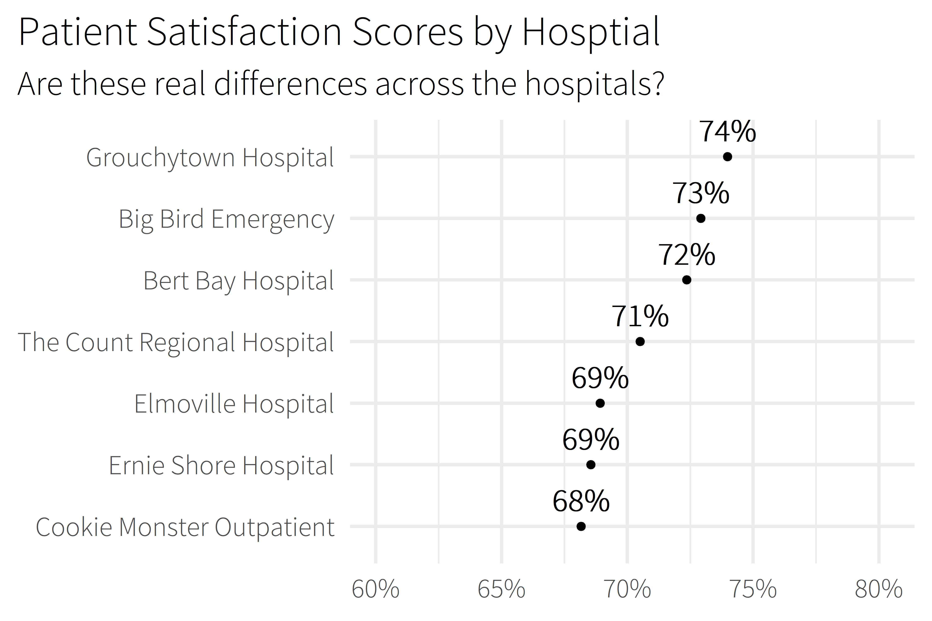
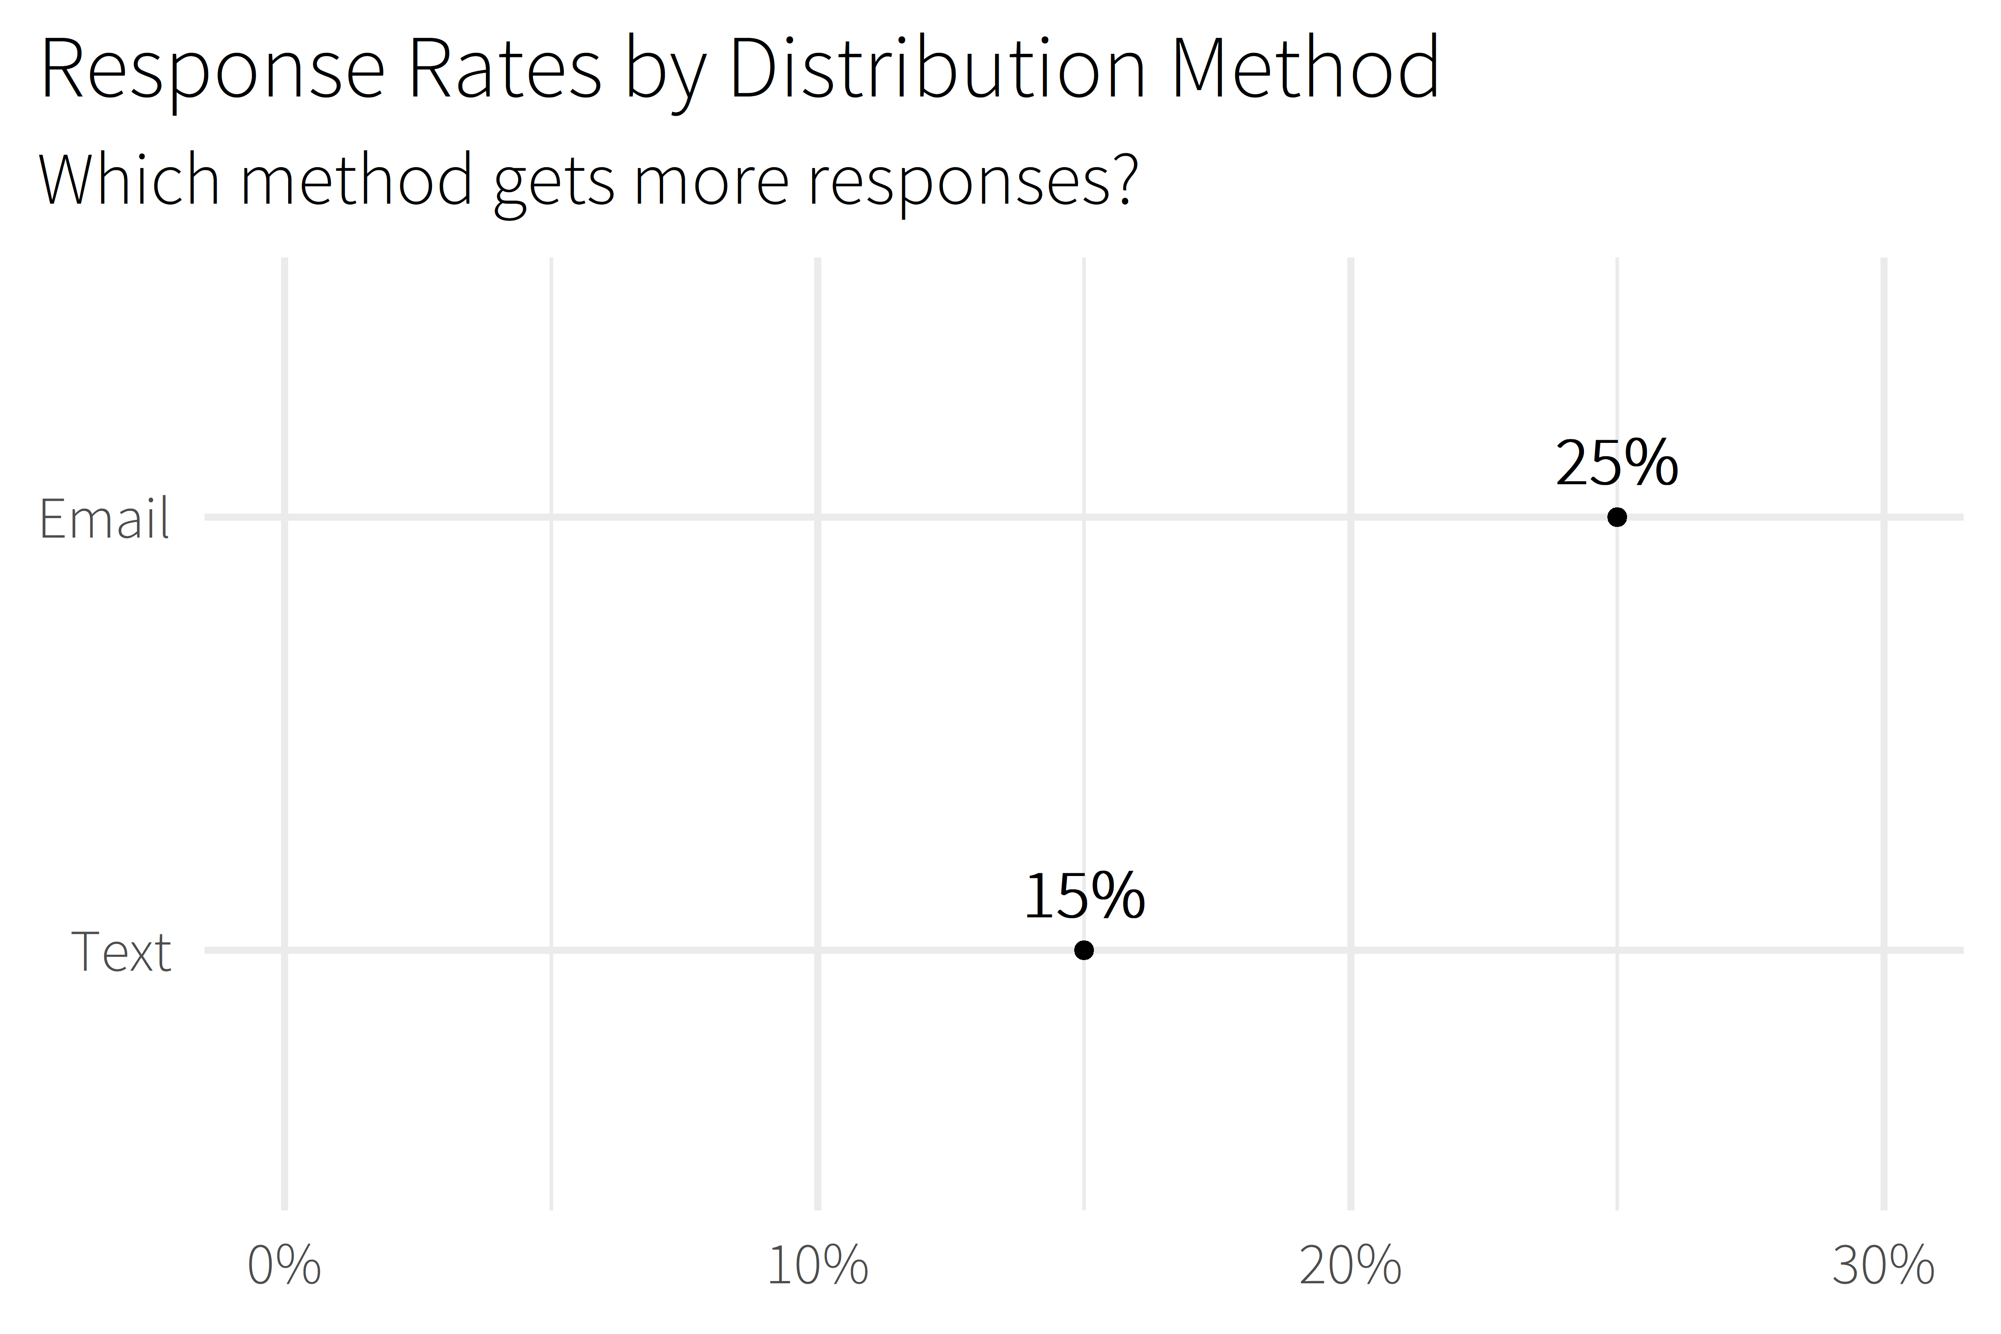

Slide 14
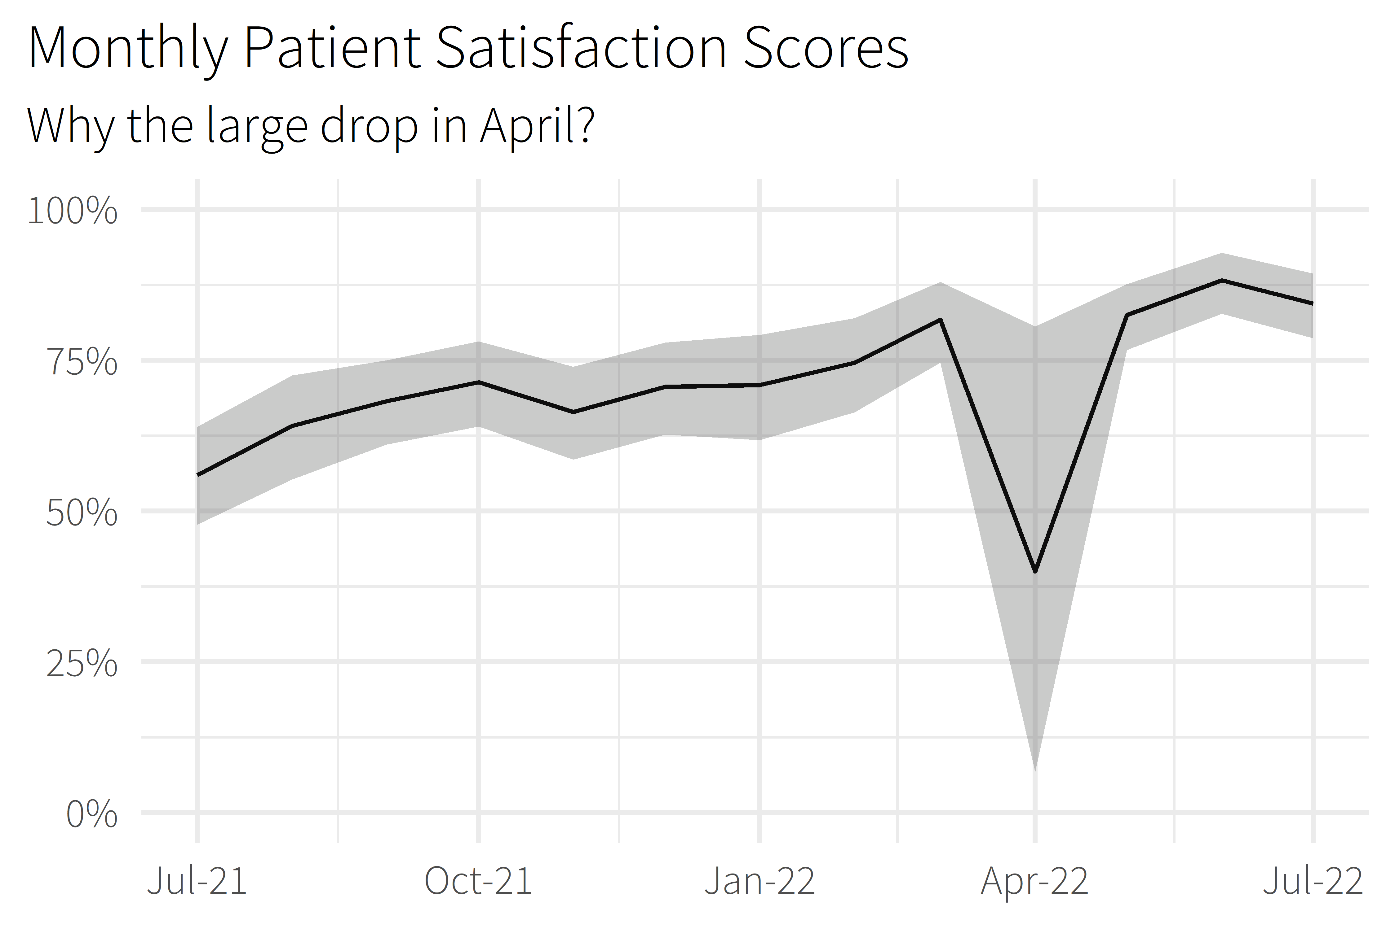

Slide 15
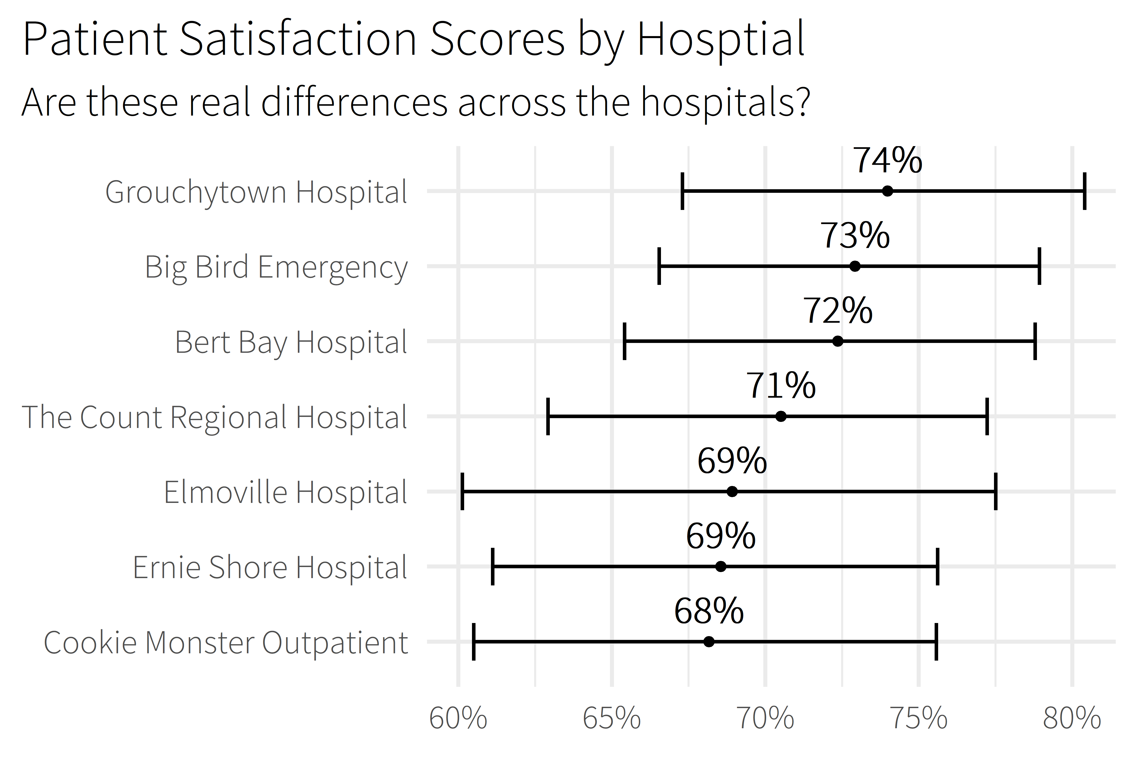

Slide 16
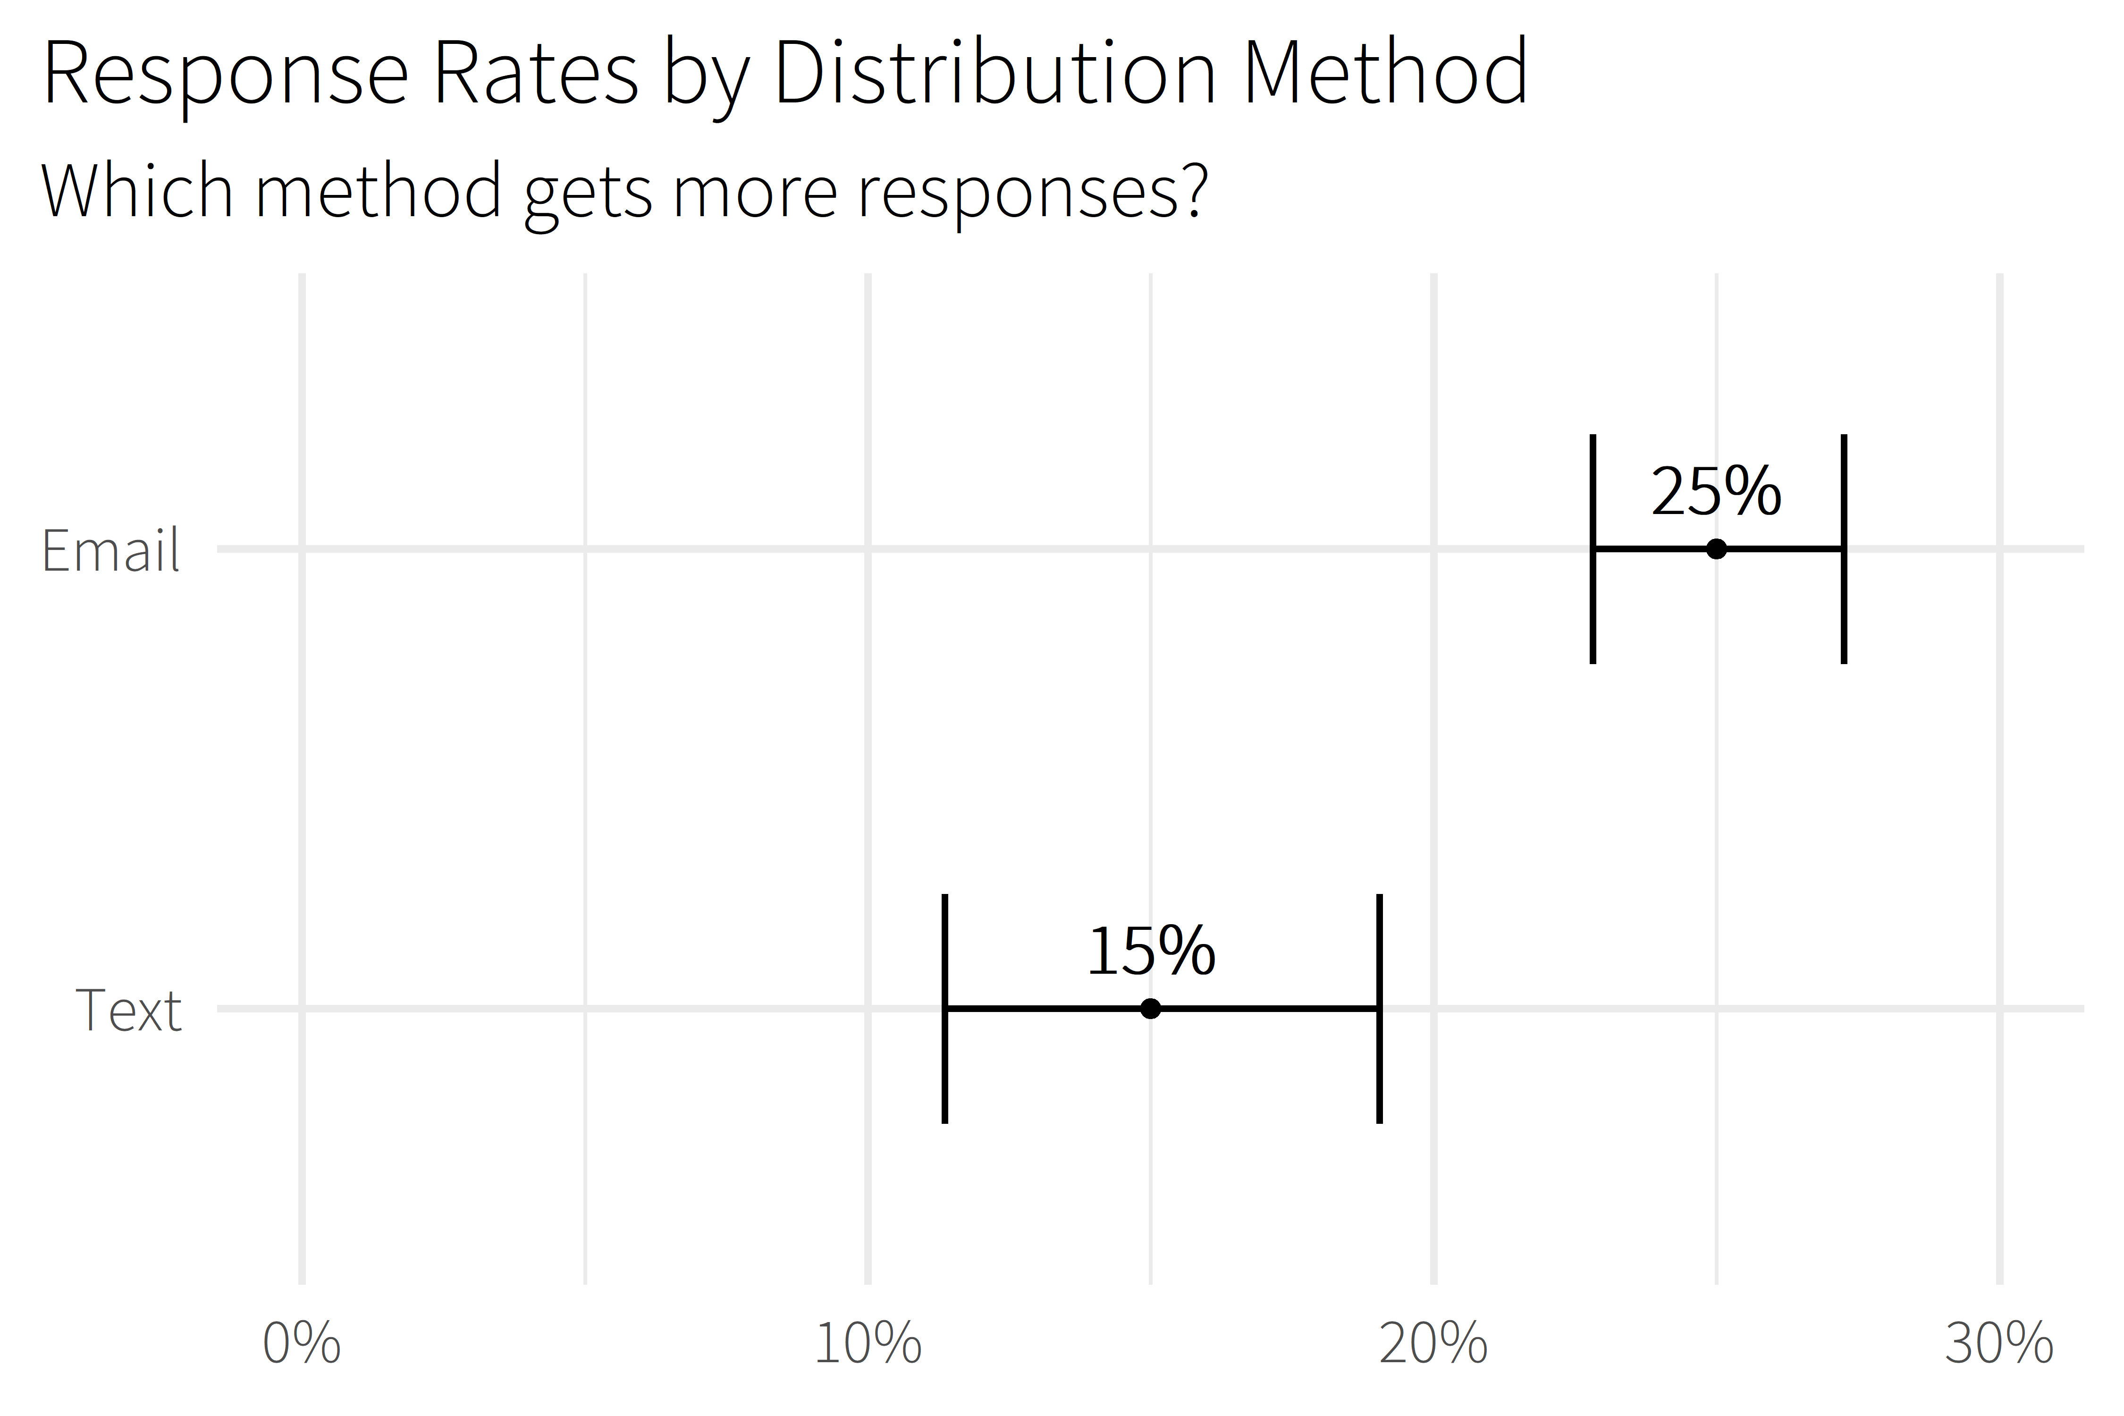

Slide 17

5.0 (19)
4.6 (2,280)

Slide 18
What are the drivers of patient satisfaction?
What will our score be?
How many responses are we expecting?
Notes:
Senior consumer experience analyst for Memorial Hermann Health System
Large hospital system in Houston
17 hospitals (11 acute-care)
Hundreds of clinics
Around 30,000 employees
Small but mighty team of 4 – thankful that they’re holding down the fort
Work with patient satisfaction surveys

Slide 19

lm()
me
XGBoost

Slide 20
Prediction Intervals
{workboots}
Powerful Models
via bootstrap resampling

Slide 21
Package Overview

Slide 22
“how this works” section
High-level review of bootstrapping
High-level review of methodology (train a bunch of models to get a bunch of possible outcomes)
where workboots sits in the model timeline

Slide 23
model building timeline
EDA
Model Fit
Model Evaluation
Feature Engineering
Model Finalization
Model Tuning
Notes:
Slide I totally stole from Julia Silge!

Slide 24
model building timeline
workboots
tidymodels
EDA
Model Fit
Model Evaluation
Feature Engineering
Model Finalization
Model Tuning
Notes:
Slide I totally stole from Julia Silge!

Slide 25
workboots checklist
Normally distributed residuals
Time to run
Actually need powerful model

Slide 26
using workboots
Set up a workflow
Generate predictions
Summarise results

Slide 27
set up a workflow
library(tidymodels)

Slide 28
set up a workflow
library(tidymodels)
# setup our data
data(“penguins”)
penguins <- penguins %>% drop_na()

Slide 29
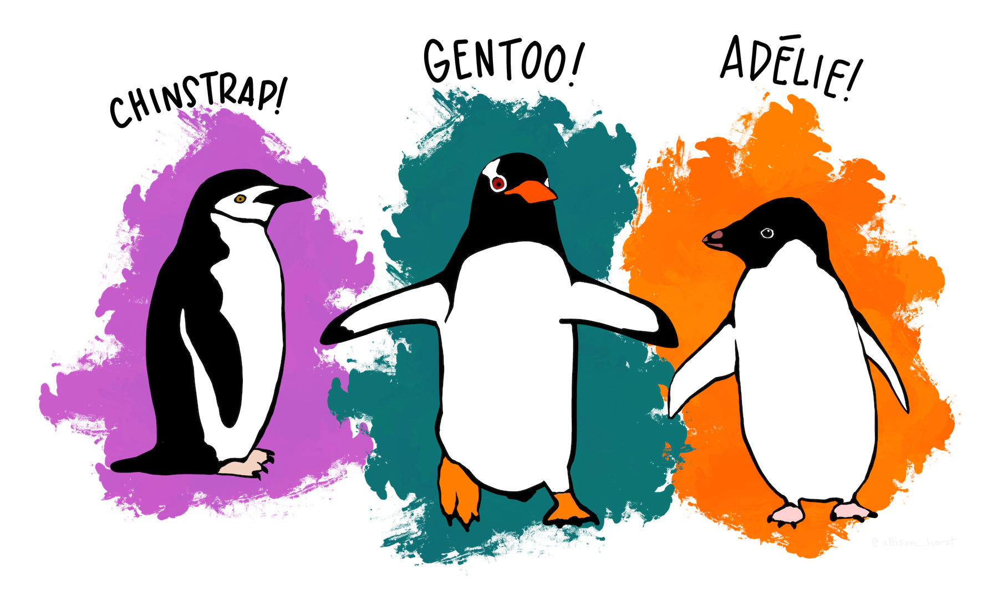
set up a workflow
library(tidymodels)
# setup our data
data(“penguins”)
penguins <- penguins %>% drop_na()

Slide 30
set up a workflow
penguins %>% glimpse()
#> Rows: 333
#> Columns: 7
#> $ species <fct> Adelie, Adelie, Adelie, ...
#> $ island <fct> Torgersen, Torgersen, To...
#> $ bill_length_mm <dbl> 39.1, 39.5, 40.3, 36.7, ...
#> $ bill_depth_mm <dbl> 18.7, 17.4, 18.0, 19.3, ...
#> $ flipper_length_mm <int> 181, 186, 195, 193, 190,...
#> $ body_mass_g <int> 3750, 3800, 3250, 3625, ...
#> $ sex <fct> male, female, female, fe...

Slide 31
set up a workflow
library(tidymodels)
# setup our data
data(“penguins”)
penguins <- penguins %>% drop_na()
set.seed(123)
penguins_split <- initial_split(penguins)
penguins_test <- testing(penguins_split)
penguins_train <- training(penguins_split)

Slide 32
set up a workflow
# setup a basic preprocessing recipe
penguins_rec <-
recipe(body_mass_g ~ ., data = penguins_train) %>%
step_dummy(all_nominal())

Slide 33
set up a workflow
# setup a basic preprocessing recipe
penguins_rec <-
recipe(body_mass_g ~ ., data = penguins_train) %>%
step_dummy(all_nominal())
# put together a workflow
penguins_wf <-
workflow() %>%
add_recipe(penguins_rec) %>%
add_model(boost_tree(“regression”))
Notes:
Notes
All tuning parameters finalized (in this case, we’re just using the defaults)
Workflow hasn’t been fit

Slide 34
generate predictions
library(workboots)

Slide 35

generate predictions
library(workboots)

Slide 36
generate predictions
library(workboots)
# generate a bootstrap prediction interval
set.seed(345)
penguins_preds <-
penguins_wf %>%
predict_boots(
n = 2000,
training_data = penguins_train,
new_data = penguins_test,
interval = “prediction”
)

Slide 37
generate predictions
library(workboots)
# generate a bootstrap prediction interval
set.seed(345)
penguins_preds <-
penguins_wf %>%
predict_boots(
n = 2000,
training_data = penguins_train,
new_data = penguins_test,
interval = “prediction”
)
Notes:
Number of bootstrap predictions to make

Slide 38
generate predictions
library(workboots)
# generate a bootstrap prediction interval
set.seed(345)
penguins_preds <-
penguins_wf %>%
predict_boots(
n = 2000,
training_data = penguins_train,
new_data = penguins_test,
interval = “prediction”
)
Notes:
Supply both our training data and new data in one step, since we’ll be fitting and predicting with one function call

Slide 39
generate predictions
library(workboots)
# generate a bootstrap prediction interval
set.seed(345)
penguins_preds <-
penguins_wf %>%
predict_boots(
n = 2000,
training_data = penguins_train,
new_data = penguins_test,
interval = “prediction”
)
Notes:
Supply both our training data and new data in one step, since we’ll be fitting and predicting with one function call

Slide 40
generate predictions
penguins_preds
#> # A tibble: 84 x 5
#> rowid .preds
#> <int> <list>
#> 1 1 <tibble [2,000 x 2]>
#> 2 2 <tibble [2,000 x 2]>
#> 3 3 <tibble [2,000 x 2]>
#> 4 4 <tibble [2,000 x 2]>
#> 5 5 <tibble [2,000 x 2]>
#> # ... With 79 more rows
Notes:
Returns a tibble with 2000 nested predictions for each observation. In this case, each row represents a penguin in the penguins_test dataset.

Slide 41
summarise results
penguins_preds %>%
summarise_predictions() %>% select(-.preds)
#> # A tibble: 84 x 5
#> rowid .pred .pred_lower .pred_upper
#> <int> <dbl> <dbl> <dbl>
#> 1 1 3465. 2913. 3994.
#> 2 2 3535. 2982. 4100.
#> 3 3 3604. 3050. 4187.
#> 4 4 4157. 3477. 4764.
#> 5 5 3868. 3305. 4372.
#> # ... With 79 more rows
Notes:
Returns a tibble with 2000 nested predictions for each observation. In this case, each row represents a penguin in the penguins_test dataset.

Slide 42
generate predictions
library(workboots)
# generate a bootstrap prediction interval
set.seed(345)
penguins_preds <-
penguins_wf %>%
predict_boots(
n = 2000,
training_data = penguins_train,
new_data = penguins_test,
interval = “prediction”
)

Slide 43
generate predictions
library(workboots)
# generate a bootstrap prediction interval
set.seed(345)
penguins_preds <-
penguins_wf %>%
predict_boots(
n = 2000,
training_data = penguins_train,
new_data = penguins_test,
interval = “prediction”
)
Notes:
By default, predict_boots() will generate a prediction interval

Slide 44
generate predictions
library(workboots)
# generate a bootstrap prediction interval
set.seed(345)
penguins_preds <-
penguins_wf %>%
predict_boots(
n = 2000,
training_data = penguins_train,
new_data = penguins_test,
interval = “confidence”
)
Notes:
But we can also generate

Slide 45
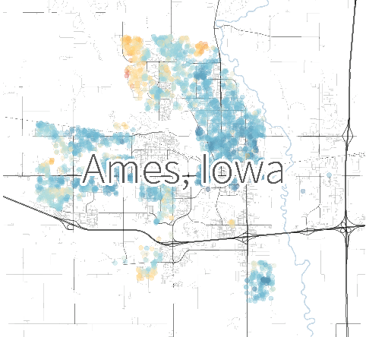
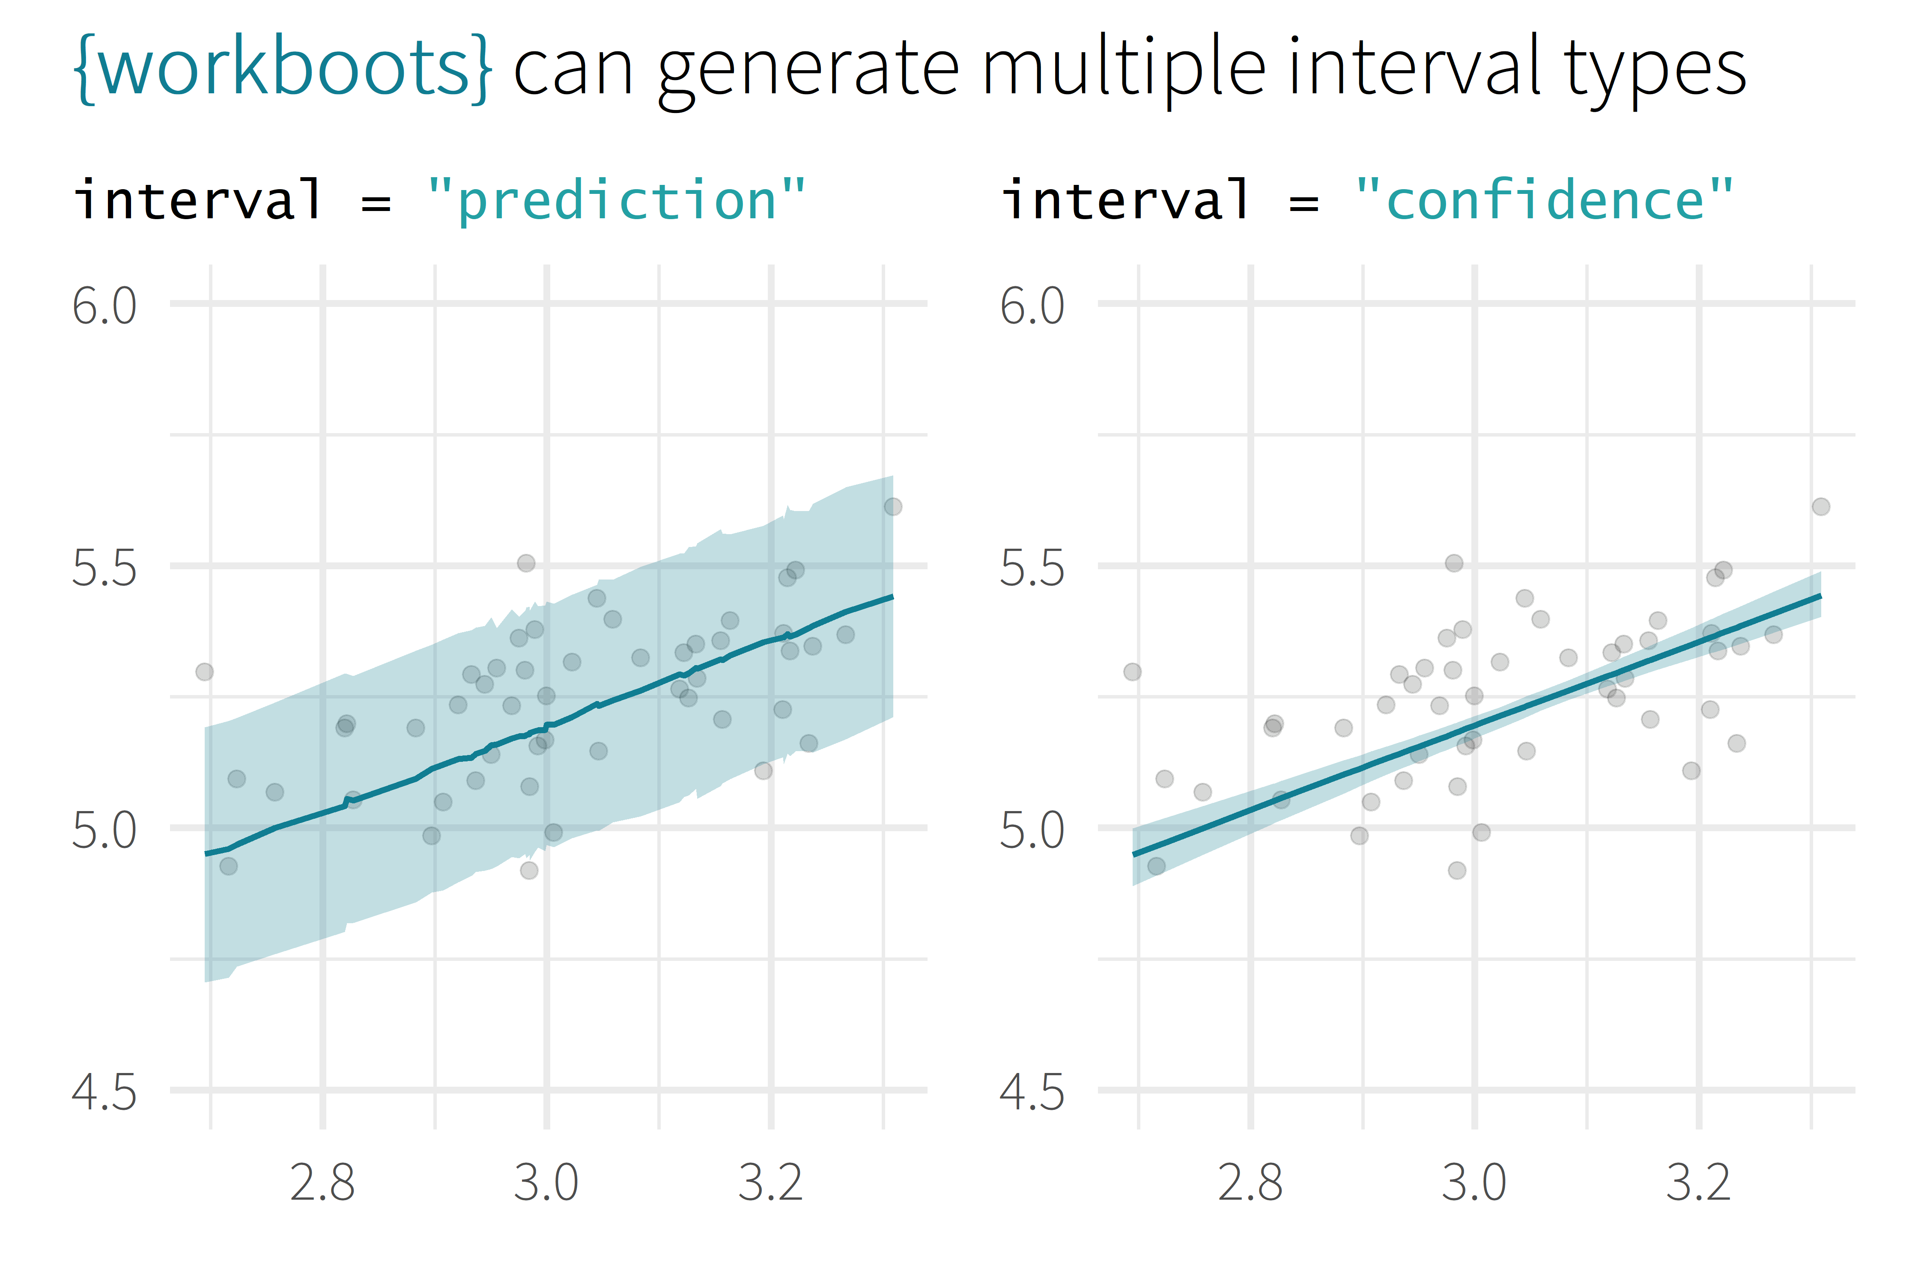
Remember to give a description of Ames dataset:
Predicting the price of a home’s sale price in Ames, Iowa
log10(Sale_Price)
log10(First_Flr_SF)

Slide 46
generate importances
# generate a bootstrap variable importances
set.seed(345)
penguins_vi <-
penguins_wf %>%
vi_boots(
n = 2000,
training_data = penguins_train
)
Remind people what feature importance is:
Methods of measuring feature importance vary depending on model type
More important features have a greater impact on the model’s prediction

Slide 47
generate importances
penguins_vi
#> # A tibble: 8 x 2
#> variable .importances
#> <int> <list>
#> 1 flipper_length_mm <vi [2,000 x 2]>
#> 2 species_Gentoo <vi [1,928 x 2]>
#> 3 bill_length_mm <vi [2,000 x 2]>
#> 4 bill_depth_mm <vi [2,000 x 2]>
#> 5 sex_male <vi [2,000 x 2]>
#> # ... With 3 more rows

Slide 48
summarise importances
penguins_vi %>%
summarise_importance() %>% select(-.importances)
#> # A tibble: 8 x 2
#> variable .importance .importance_lower
#> <int> <dbl> <dbl>
#> 1 flipper_length_mm 0.464 0.254
#> 2 species_Gentoo 0.402 0.044
#> 3 bill_length_mm 0.045 0.027
#> 4 bill_depth_mm 0.040 0.024
#> 5 sex_male 0.046 0.020
#> # ... With 3 more rows, and 1 more variable:
#> # .importance_upper <dbl>

Slide 49
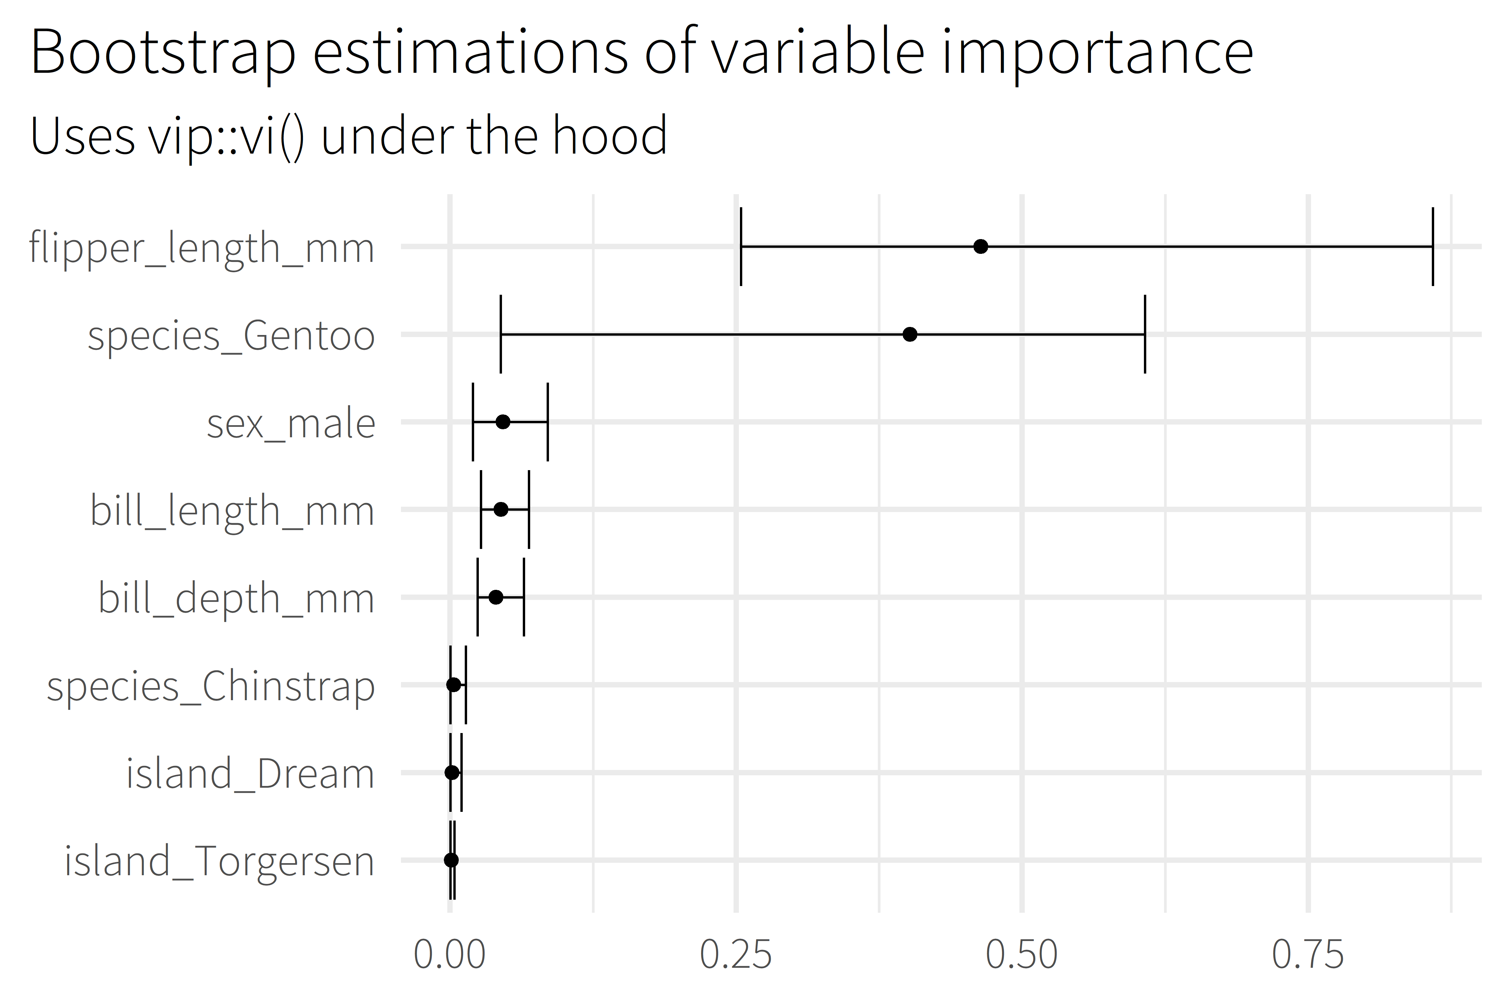
Talk about the features themselves, e.g.,
According to this model, the length of a penguin’s flipper is way more important to figuring out their weight than which island the penguin comes from
Notes:
Uses the vip package under the hood to estimate model-specific importance.
Some model types aren’t supported by vip

Slide 50
Call to action (use my package plz)
Closing
Links, acknowledgements, resources

Slide 51
additional resources
Packages
ngboostForecast : Probabilistic forecasting with Python’s ngboost [CRAN/github]
ggdist : Visualizations of distributions and uncertainty [CRAN/github]
spin : Functions for simulating prediction intervals [github]
ungeviz : Tools for visualizing uncertainty with ggplot2 [github]
Reading
Bootstrap Methods and their Application, (Davison and Hinkley)
Improvements on Cross Validation – the .632+ Bootstrap Method, (Efron and Tibshirani)
Tidy Modeling with R (Kuhn and Silge)
Applied Predictive Modeling (Kuhn and Johnson)

Slide 52
Backup

Slide 53
overview
Selling Point
About me
Motivation / Background
Package overview
Cost of doing business
(1 min)
(2 min)
(5 min)
(5 min)
(5 min)

